Slide 1
Smart Study Planner
CAPSTONE PROJECT
Presented By:
Student Name- VAISHNAVI G M
College Name- Bapuji Institute Of Hi-Tech Education,Davangere
Department- BCA
Student ID- STU68b074eceeb5b1756394732
Internship ID: INTERNSHIP_17545746406894af305aa93

Slide 2
OUTLINE
Problem Statement (Should not include solution)
System Development Approach (Technology Used)
Algorithm & Deployment (Step by Step Procedure)
Result
Conclusion
Future Scope(Optional)
References

Slide 3
Problem Statement
Task Input Form:
Allows users to enter a task title and a deadline.
Validates that both fields are filled before submission.
Task List:
Displays all user-created tasks in a structured list.
Each task shows its title, deadline, and action buttons.
Task Actions:
Mark as Done: Toggles the completion status of a task.
Delete Task: Removes the task from the list.
Completed tasks are visually styled (strikethrough and faded).
Progress Bar:
Shows the percentage of completed tasks out of the total.
Updates dynamically as tasks are completed or deleted.
Local Storage Integration:
Tasks persist across page reloads by storing them in the browser's localStorage.

Slide 4
System Approach
Frontend Technologies:
HTML5 – Structure of the webpage
CSS3 – Styling and responsive layouts
JavaScript – Dynamic interactivity (cart, filtering, total calculation)
Design Approach:
Clean and user-friendly interface
Mobile-responsive design
Modular separation of HTML, CSS, and JS files

Slide 5
Algorithm & Deployment
Frontend Design
Layout using HTML,CSS and JAVA SCRIPT(grid & cards).
Interactive Features
. Add New Task
Display Tasks Dynamically
. Mark Task as Completed / Toggle Status
Delete Task
Live Progress Bar
Persistent Data via Local Storage
Button Hover and Click Effects
Testing
Cross-browser compatibility
Mobile responsiveness
Deployment
Host using GitHub Pages.

Slide 6
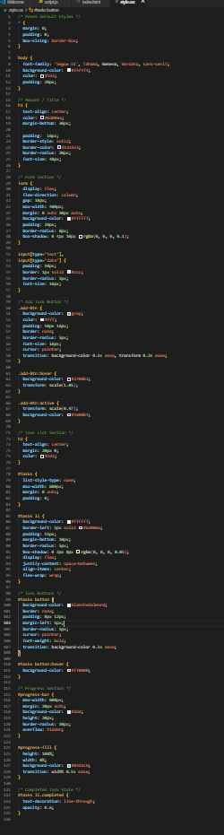
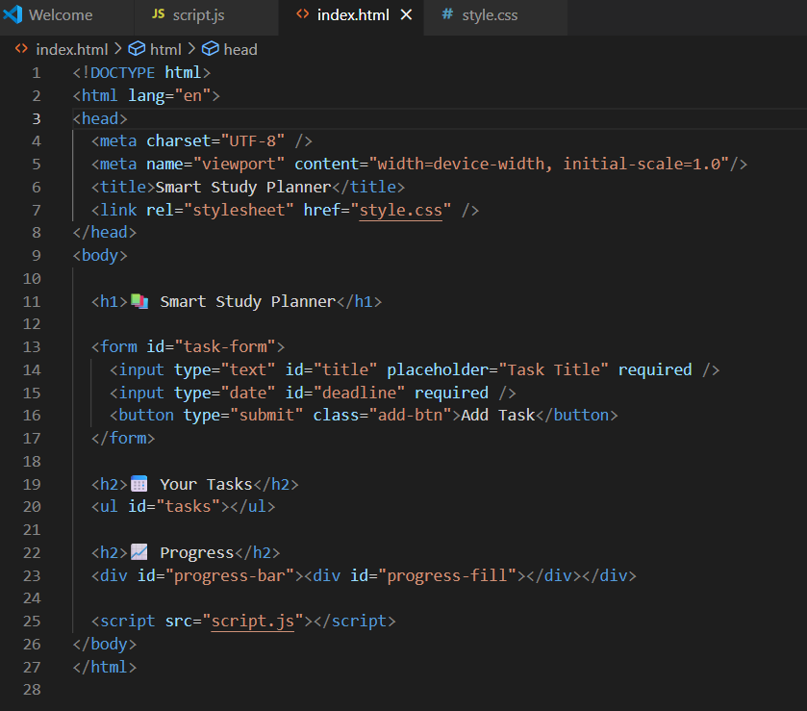
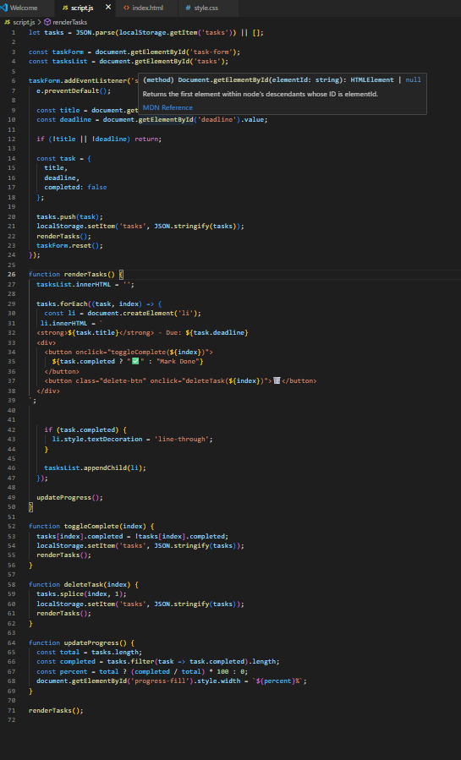
Result

Slide 7
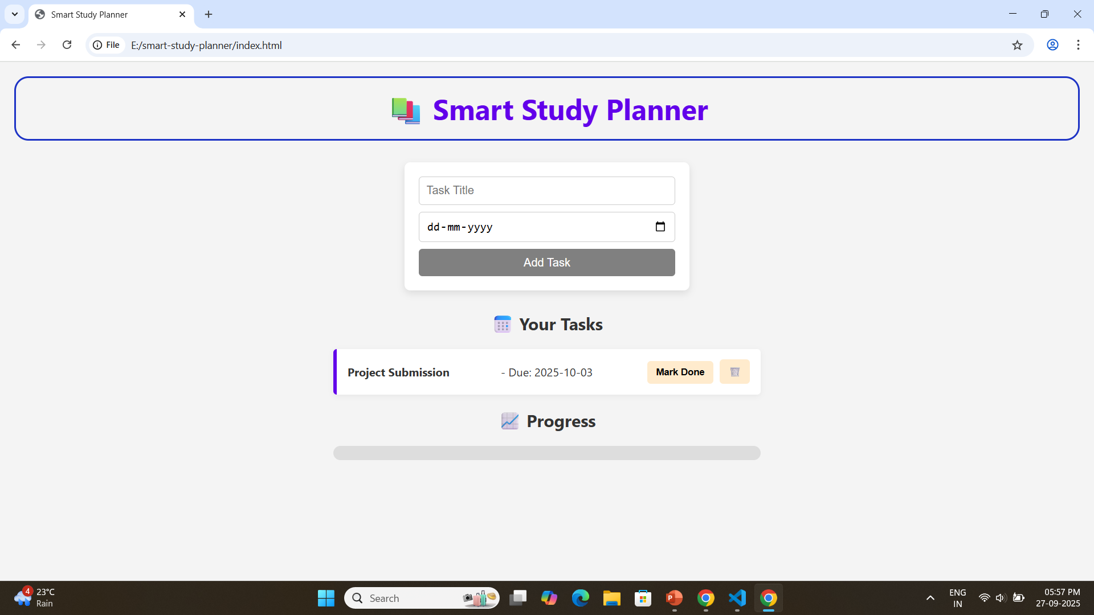
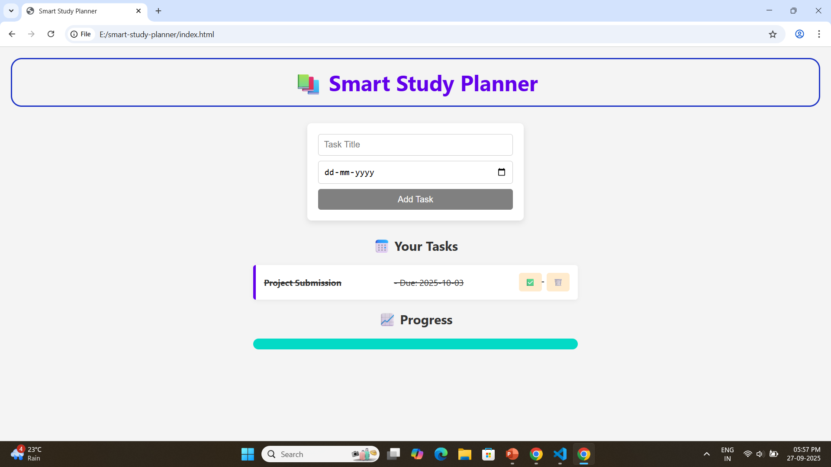
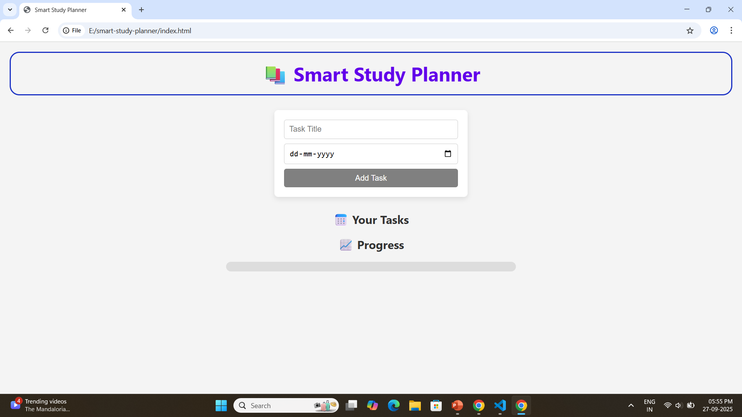
Result

Slide 8
GITHUB AND DEPLOYMNET LINK
Github Link : https://github.com/Vaishnavi-g-m-coder/smart-study-planner
Deployment link: https://github.com/Vaishnavi-g-m-coder/smart-study-planner.git

Slide 9
Conclusion
User-Friendly Design:
Clean and intuitive interface makes task management simple for all users.
Efficient Task Management:
Users can easily add, complete, and delete tasks with real-time updates.
Progress Visualization:
A dynamic progress bar provides immediate visual feedback on task completion.
Data Persistence:
Tasks are saved using localStorage, ensuring data remains even after page reloads.
Interactive Features:
Buttons with hover/click effects and completed task styling enhance user engagement.
Responsive Layout:
The app adapts well across different screen sizes, improving accessibility.
Practical Use Case:
Helps users stay organized, manage deadlines, and improve productivity in daily study or work routines.

Slide 10
Future scope(Optional)
Notifications & Reminders: Implement alerts or email notifications to remind users of upcoming deadlines.
Task Categories and Tags: Allow users to categorize or tag tasks (e.g., subjects, projects) for better organization and filtering.
Drag-and-Drop Reordering: Enable users to reorder tasks via drag-and-drop for customized task prioritization.
Sync Across Devices: Integrate cloud storage or user authentication so tasks sync across multiple devices.

Slide 11
References
Google Developers Web Fundamentals — Guided the creation of a responsive and user-friendly interface, following web accessibility best practices.
Design Inspiration — Adapted common features and UI patterns from popular task management apps to enhance usability and interactivity.

Slide 12
THANK YOU

